Slide 1
Video Game Online Store
By Jacob Shay

Slide 2
Mini-World
The database is an online retail store that sells video games ranging from Xbox 360, PlayStation 3, Wii U games, and PC Games. Games are only shipped individually and shipped only to residence of the United States. Customers will purchase games with a credit card through an account that they create on the website. Returns are accepted within thirty business days.

Slide 3
Goals
Being able to recognize when the store needs new supplies from supplier.
Items are automatically ordered if there are less than 5 items.
Fast & Easy Shipping
Packages are always shipped one day after purchase. Packages have tracking information.
Credit cards are charged instantly

Slide 4
Transactions
Purchase-customer buys the product. Store receives the funds from users credit card
Return-customers can return the product within 30 days from purchase however they pay for shipping back.
Purchase order-The Employee orders a product from the supplier
Shipment-The employee shipped the game to the customer from the warehouse.

Slide 5
Entities
Customers-Users who are registered with the online store. Full name, address, credit card number, phone number, and date user registered.
Video Games-A single physical disc that can be on various different platforms. Title, rating, and Platform.
Distributor-Company that is authorized to sell video games to the video game store. Name, Number, Address.
Employee-A person who works for the online shop, Employee makes purchase orders for the product, shipping products to customers, and receiving funds. Has job title, name, date of hiring, and salary.
Position-The positions for the employees in the video game store.

Slide 6
Indirect Users
Store Owner- Has access to all of the information but can not modify it.

Slide 7
Direct Users
Customers-can view and buy products from the website.
Database administrator-person responsible for modifying the database, controlling and monitoring user access, backup and recovery.

Slide 8
Outputs
Financial report-Information regarding the balance of the store.
Inventory Report-Information on the status of the items in the inventory. If any item is equal to zero then these items need to be ordered.
Shipment status report. Item is showed as shipped or packaging.
Shipping history-List of completed shipments. Includes Customer name, Video Game name, Shipment date, and Shipment number.

Slide 9
Outputs Continued
Purchase Order Report-List of purchase orders for a given date.

Slide 10
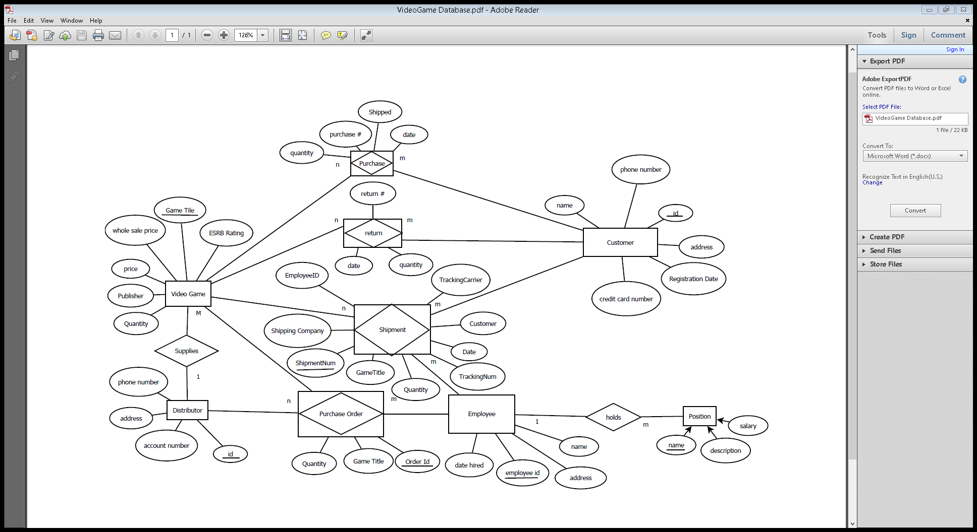

Slide 11
